Slide 1

Lecture 6 Edge Detection
COMP3204 Computer Vision
What are edges and how do we find them?
 | Book pp 143 - 153

Slide 2
Content
Differentiation/ differencing can be used to find edges of features
How can we improve the differencing process?

Slide 3
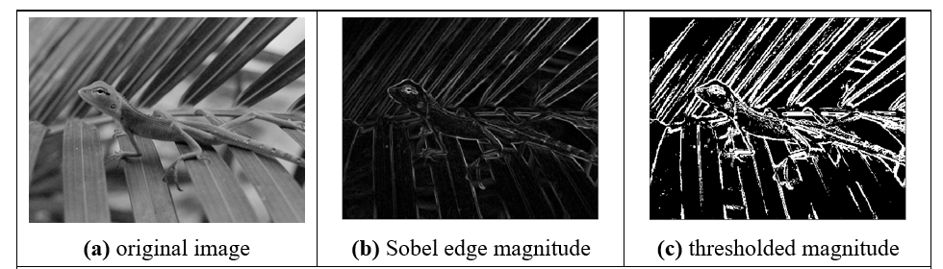

Edge detection
What is an edge? It’s contrast

Slide 4
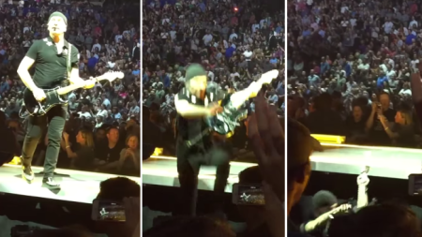
U2’s Edge can’t detect edges
http://metro.co.uk/2015/05/15/the-edge-falls-off-the-edge-of-the-stage-in-spectacular-style-during-u2s-world-tour-5199503/

Slide 5


Horizontal differencing
difference
result
Horizontal differencing detects vertical edges

Slide 6

Vertical differencing
difference
Vertical differencing detects horizontal edges
result

Slide 7
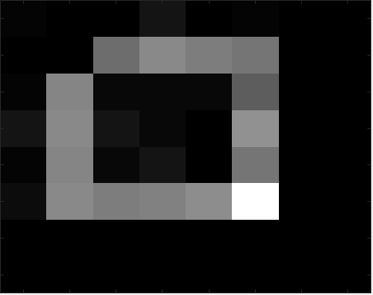
First order edge detection
Addition of horizontal and vertical

Slide 8



First order edge detection
vertical edges, Ex
horizontal edges, Ey
vertical and horizontal edges

Slide 9

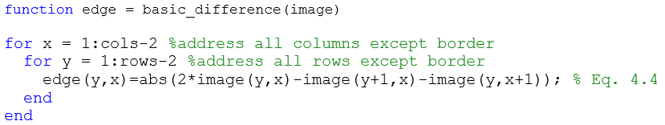
First order edge detection
Template
Code
How can we improve it?

Slide 10
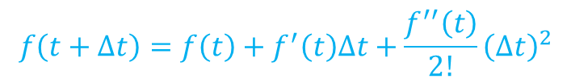



Taylor series – evaluate $f\left(t+∆t\right)$
First approximation, original value
$$f\left(t+∆t\right)=f\left(t\right)$$
Second approximation, add gradient
$$f\left(t+∆t\right)=f\left(t\right)+f^{′}\left(t\right)∆t$$
Third approximation, add f’’
$$f\left(t+∆t\right)=f\left(t\right)+f^{′}\left(t\right)∆t+\frac{f^{′′}\left(t\right)}{2!}{\left(∆t\right)}^{2}$$
Taylor series
$$f\left(t+∆t\right)=f\left(t\right)+f^{′}\left(t\right)∆t+\frac{f^{′′}\left(t\right)}{2!}{\left(∆t\right)}^{2}+\frac{f^{′′′}\left(t\right)}{3!}{\left(∆t\right)}^{3}+…+\frac{f^{n}\left(t\right)}{n!}{\left(∆t\right)}^{n}$$

Slide 11
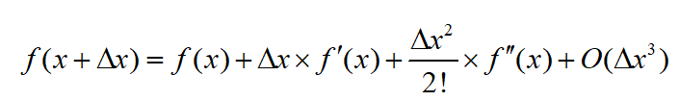

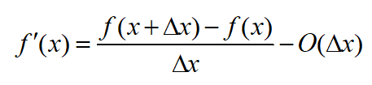







Edge detection maths
A
1 | -1
B
A − B
1 | 0 | -1

Slide 12
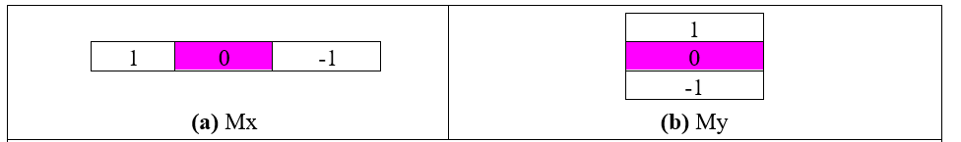
Templates for improved first order difference

Slide 13


Fireside time
Where is computer vision going?
Where is biometrics going?

Slide 14
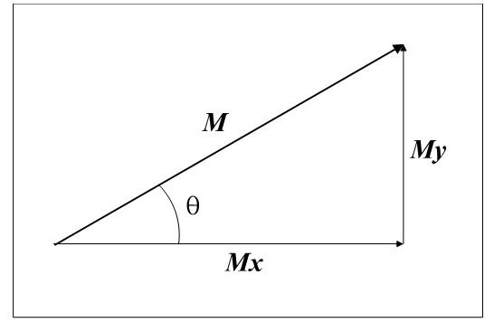

Edge Detection in Vector Format
Vectors have magnitude (strength) and direction
M = magnitude = $\sqrt{M_{x}^{2}\text{+}M_{y}^{2}}$
θ = $direction$ = $\tan^{−1}\left(\frac{M_{y}}{M_{x}}\right)$

Slide 15
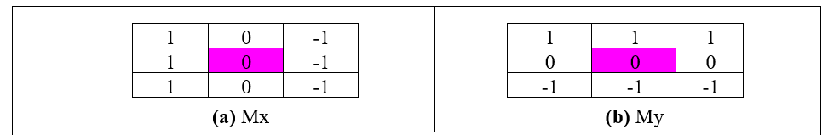
Templates for 3×3 Prewitt operator
Average improved horizontal and vertical operators over 3 rows/ columns to give Prewitt templates
Edge magnitude and direction calculated for centre point

Slide 16
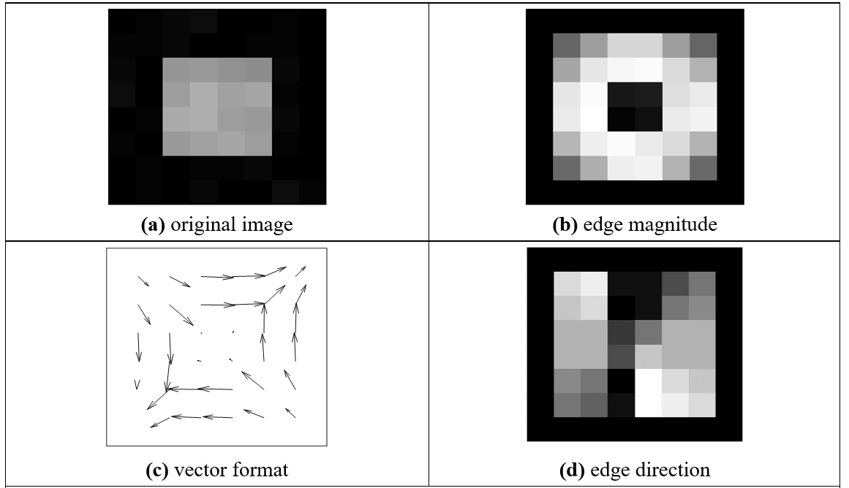
Applying the Prewitt Operator
No missing points

Slide 17
Applying the Prewitt Operator
Blurred edges

Slide 18
Applying the Prewitt Operator
No double points

Slide 19
Applying the Prewitt Operator
Displaying gradients as an image communicates nothing
So use vectors

Slide 20
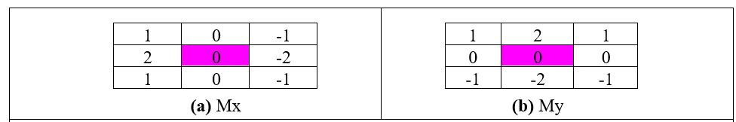
Templates for Sobel operator
Sobel is most popular basic operator
Double the centre coefficients of Prewitt
WHY?

Slide 21
Applying Sobel operator

Slide 22
Generalising Sobel - use Pascal’s triangle
1. Averaging Window size
2 1 1
3 1 2 1
4 1 3 3 1
5 1 4 6 4 1
2. Differencing Window size
2 1 -1
3 1 0 -1
4 1 1 -1 -1
5 1 2 0 -2 -1
Sobel 3×3
Sobel 5×5
Sobel 3×3
Sobel 5×5

Slide 23
Generalised Sobel
Generated by: averaging*(differencing)^{T}
>> s=Sobel_templates(5)
s(:,:,1) =
1 2 0 -2 -1
4 8 0 -8 -4
6 12 0 -12 -6
4 8 0 -8 -4
1 2 0 -2 -1

Slide 24
COURSEWORK!!!!

Slide 25
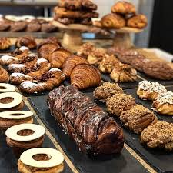
Takeaway time
1 – differencing detects contrast and thus edges
2 - can improve the differencing process (by maths!!)
3 – Sobel is a good general purpose operator
We shall go to more sophisticated methods, coming up next.
Notes:
Hoxton bakehouse, excellent bread

